Slide 1

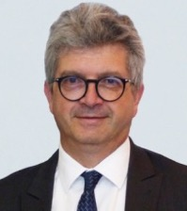
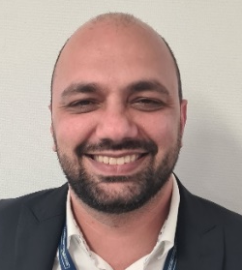
The Procurement policy aligns with supporting the Group's ambitions. It is structured around three major focus areas:
Supporting the Group in its transformation and in the implementation of a unique industrial system through the establishment of a panel of External Suppliers that meet the current and future needs of the Group.
Contributing to the significant improvement of the profitability of our activities and ensuring a high level of service quality for our Clients by developing privileged, sustainable, and balanced relationships with our top-performing External Suppliers.
Supporting the sales teams in the Group's growth dynamic by involving External Suppliers early in the Group's developments, offers, and projects, to better meet all our Clients' requirements in terms of overall cost, quality performance, and delivery deadlines compliance.
President
& CEO
Christian Cornille
To this end, the implementation of the Procurement policy is carried out through an established process as follows:
Define and promote the most appropriate Procurement strategies for the product, good, or service according to the requirements of internal stakeholders.
Involve the Procurement Department in all phases of the product lifecycle through a centralized organization.
Coordinate all Group stakeholders in relation to External Suppliers.
Qualify, select, and award contracts or agreements to External Suppliers through a clear and fair process.
Promote and deploy procedures, indicators, and management tools common to all companies within the Group.
The Procurement policy is based on the "MECACHROME Supplier Code of Conduct" validated by our selected partners, to ensure the strict application of our CSR policy within our supply chain, particularly regarding environmental respect, ethics, and deontology.
.
Procurement
VP
Alnour Monnerat

